Slide 1
Kenkre Football Club

Slide 2
Hierarchy Structure for Users
Super Admin
Coach 1
Batch 1
Student 1
Student 2
Student 3
…
Student p
Batch 2
Batch 3
…
Batch m
Coach 2
Coach 3
…
Coach n

Slide 3
Admin Panel For Kenkre Football Club
Main Modules for Back End [i.e. Admin Panel]
Login
Dashboard
Masters
Coach
Competition
Student
Notification
Reports

Slide 4
Login Module for Admin Panel
Phase I
Login module requires Username and Password which is provided by Super-Admin through Email/SMS or both
Users are Super Admin, Admin, Coach only
Student can not login through this login

Slide 5
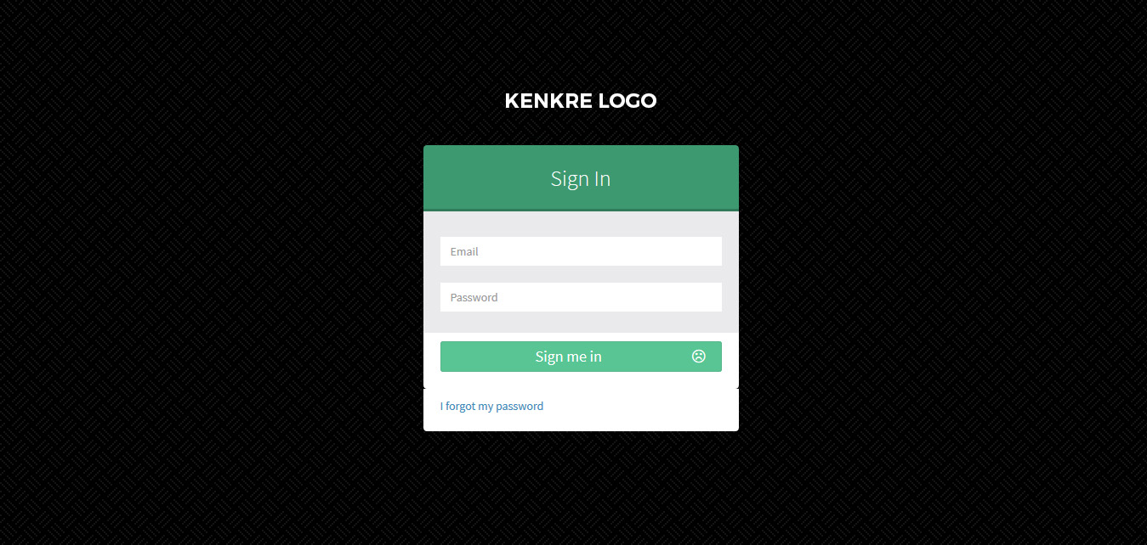
Wireframes
Login Screen

Slide 6
Phase I
Dashboard
Number of Students
Number of Competitions
Number of Batches
Today's Schedule
Tomorrow’s Schedule
Day after tomorrow’s Schedule

Slide 7
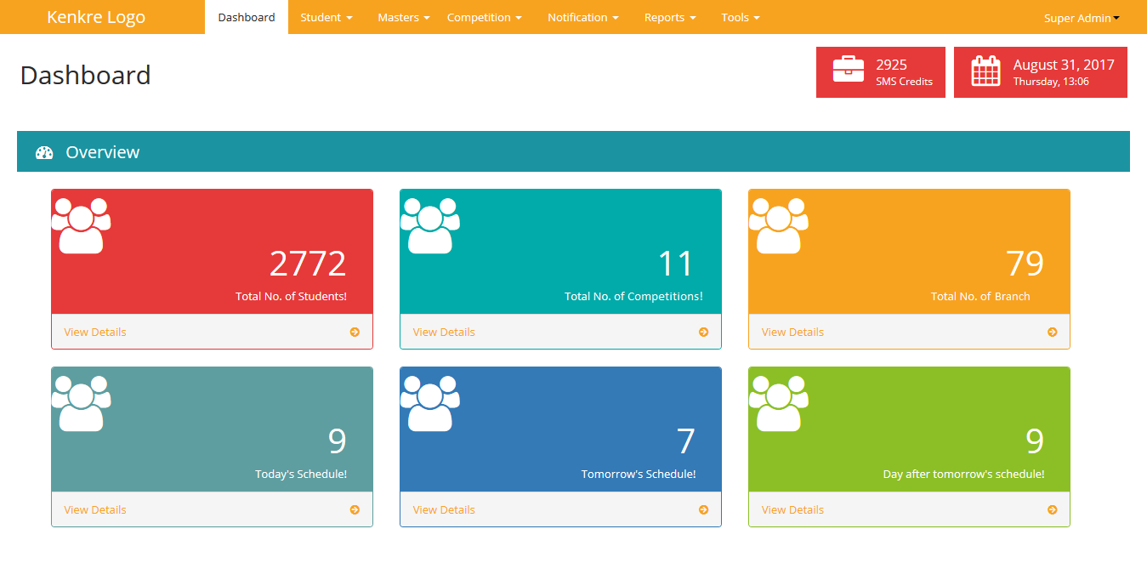
Wireframes
Dashboard

Slide 8
Phase I
Masters
Country :
In “View Country” admin user will get the list of countries whichever he added in the system.
Only “Super-Admin” and “Admin” can Add, Edit or Delete any Country record, Other Users like “Coach” can only view the records
We call it as “Masters” because this admin users will use this module in their other modules like, For getting the student address, admin user wants to be get Country, State, City, Area and Pin-code records in “Add Student” module

Slide 9
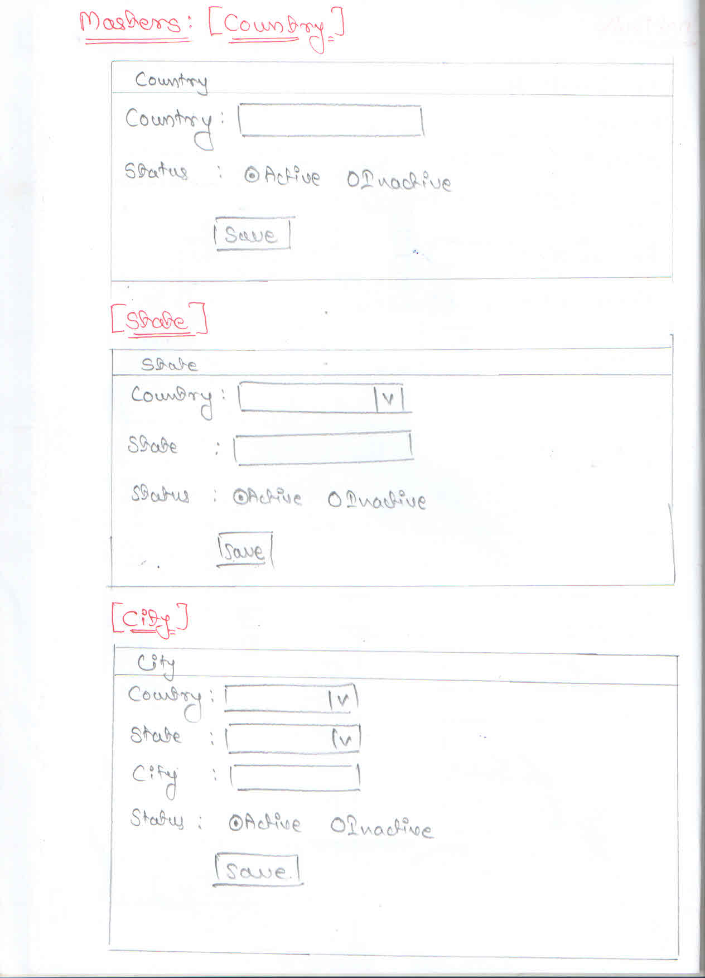
Wireframes
Country Form

Slide 10
Phase I
Masters
State:
In “View State” admin user will get the list of all the States which he added in the system.
Only “Super-Admin” and “Admin” can Add, Edit or Delete any State record, Other Users like “Coach” can only view the records
State is depending on the Country

Slide 11
Wireframes
State Form

Slide 12
Phase I
Masters
City:
In “View City” admin user will get the list of all Cities whichever he added in the system.
Only “Super-Admin” and “Admin” can Add, Edit or Delete any State record, Other Users like “Coach” can only view the records
City is depending on the Country and State selection

Slide 13
Wireframes
City Form

Slide 14
Phase I
Masters
Area:
In “View Area” admin user will get the list of all areas which he added in the system.
Only “Super-Admin” and “Admin” can Add, Edit or Delete any State record, Other Users like “Coach” can only view the records
Area is depending on the Country, State and City selection
Pin-code will be also added at the time of addition of Area

Slide 15
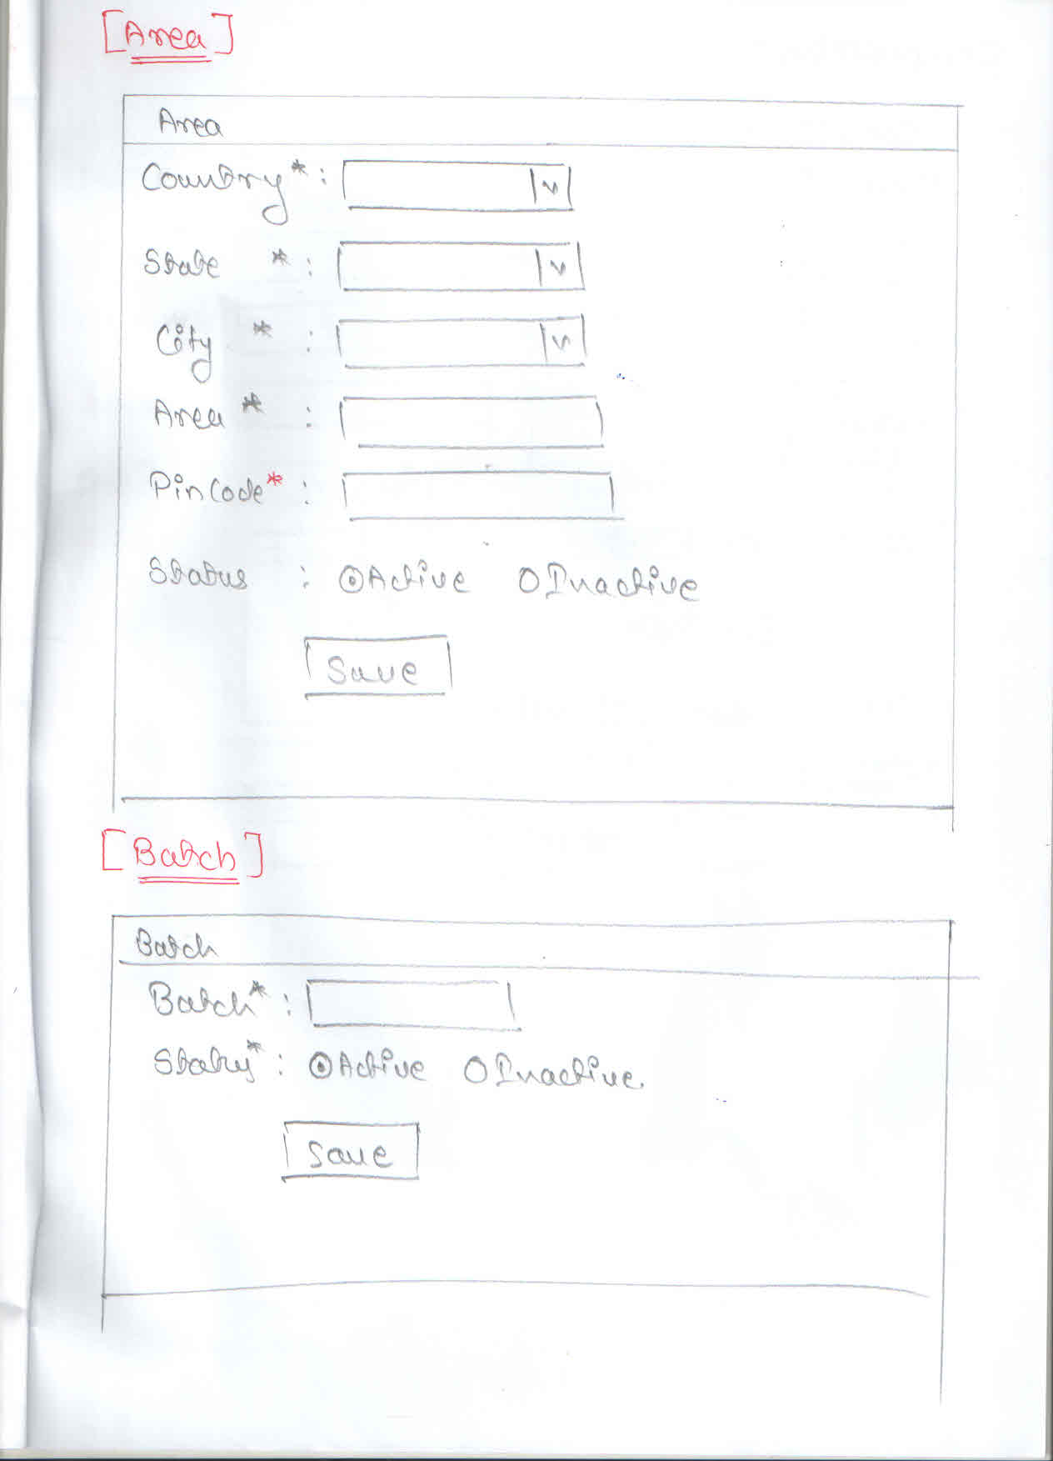
Wireframes
Area Form

Slide 16
Phase I
Masters
Batches:
Batches are related to a specific activities
Through the Batches we manage the schedule of the different activities which will be helpful for the Student
It includes day wise schedule and Duration of the Activity i.e. Start and End Date of the respective activity

Slide 17
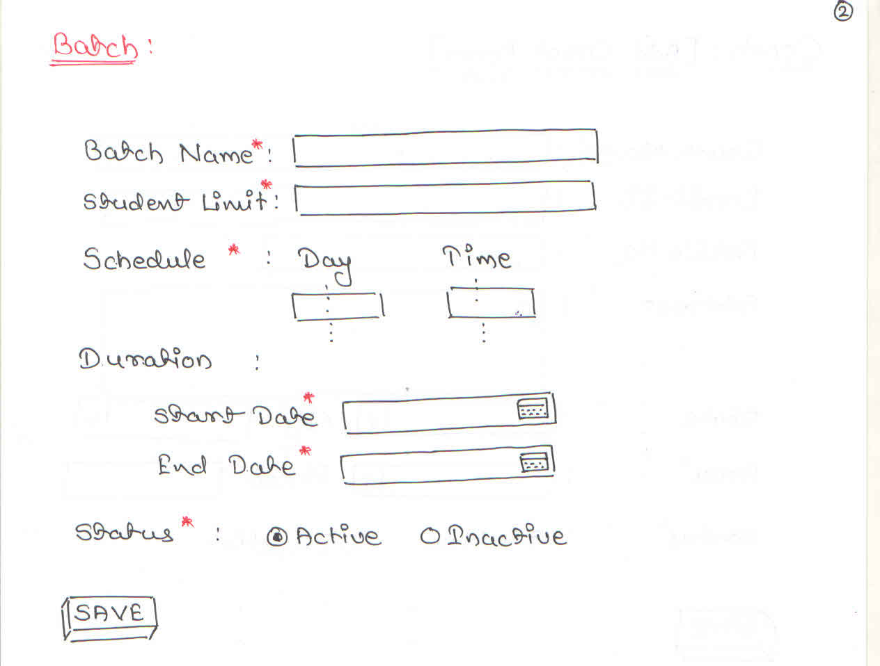
Wireframes
Batch Form

Slide 18
Phase I
Coach
Add Coach
Adding a coach will require the fields like: Name, Email ID, Mobile Number, Address and Status
Coach Rights
Dashboard,
View respective Student only
View respective Batches only
View respective Competition only
Send Notifications to his respective students only
Reports- Student, Batch, Competition, Notification, etc.

Slide 19
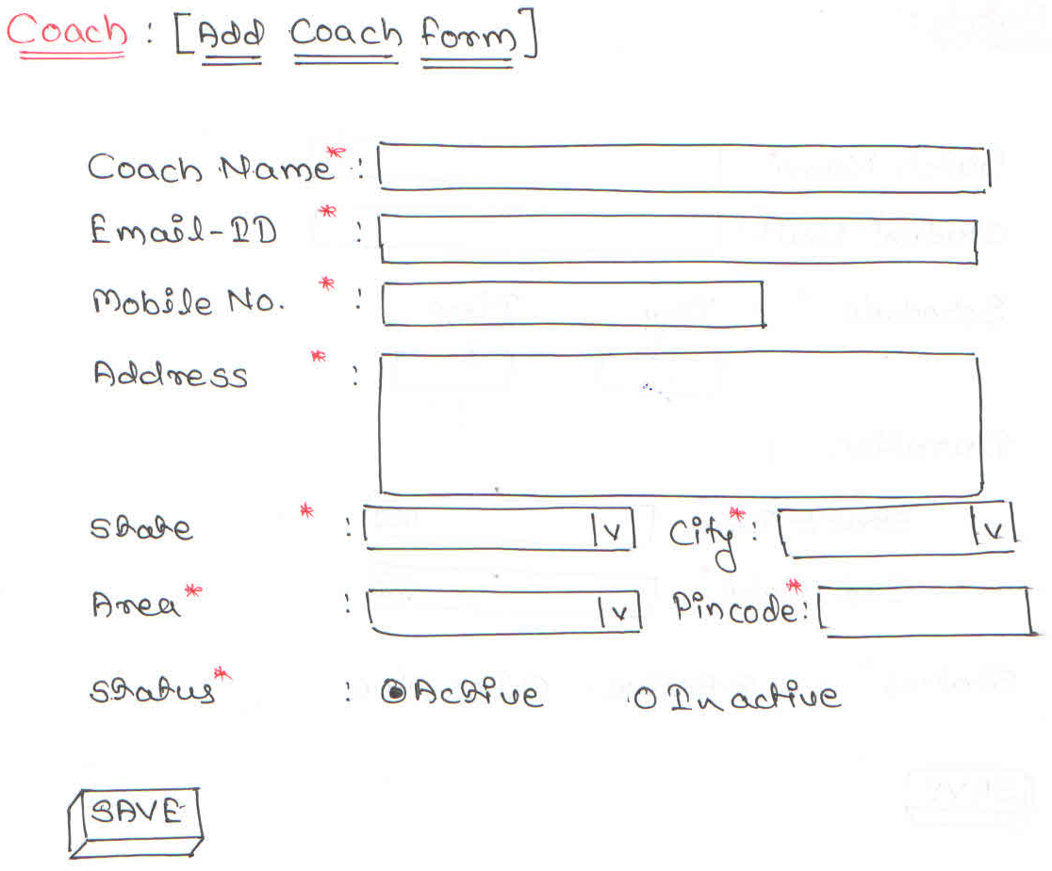
Wireframes
Add Coach Form

Slide 20
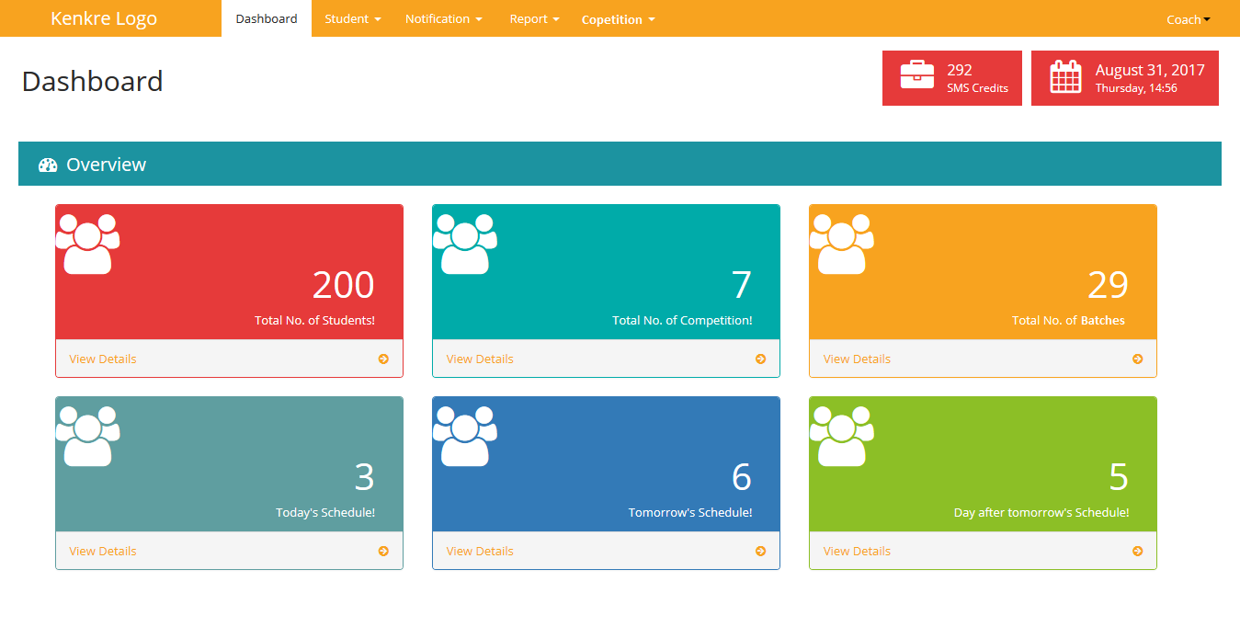
Wireframes
Coach Rights

Slide 21
Phase I
Competition
Add Competition
Super-admin can add competition and coach will then assign it to their respective students.
Fields of Competition are:
Name of Competition
Student Limit Duration (Start/End Date) Status

Slide 22
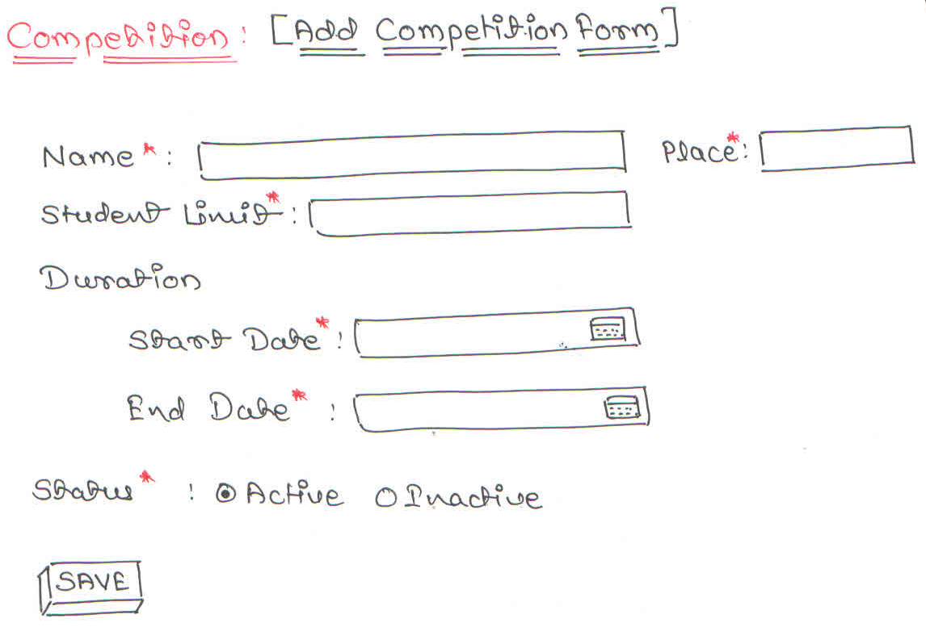
Wireframes
Competition Form

Slide 23
Phase I
Student
Add Student
This allows you to add/register student in the system which can be further modified if need arises and can be viewed in “My Account”.
My Account
In my account section, information of the students are available E.g. Name of the Student, Batches, Competition etc.

Slide 24
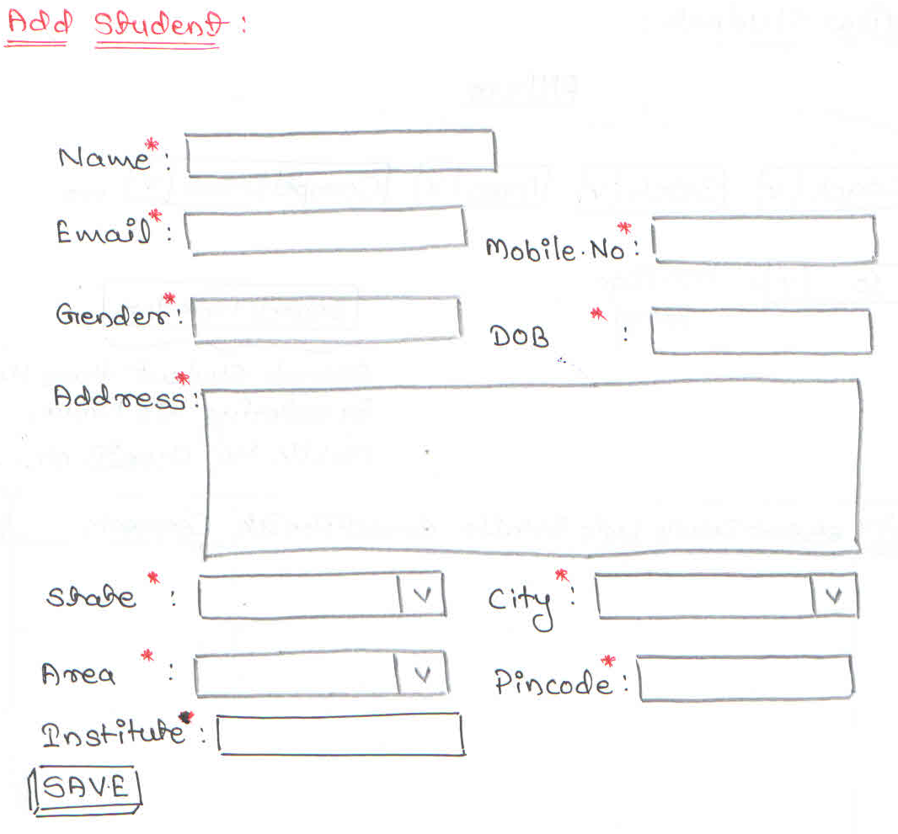
Wireframes
Add Student

Slide 25
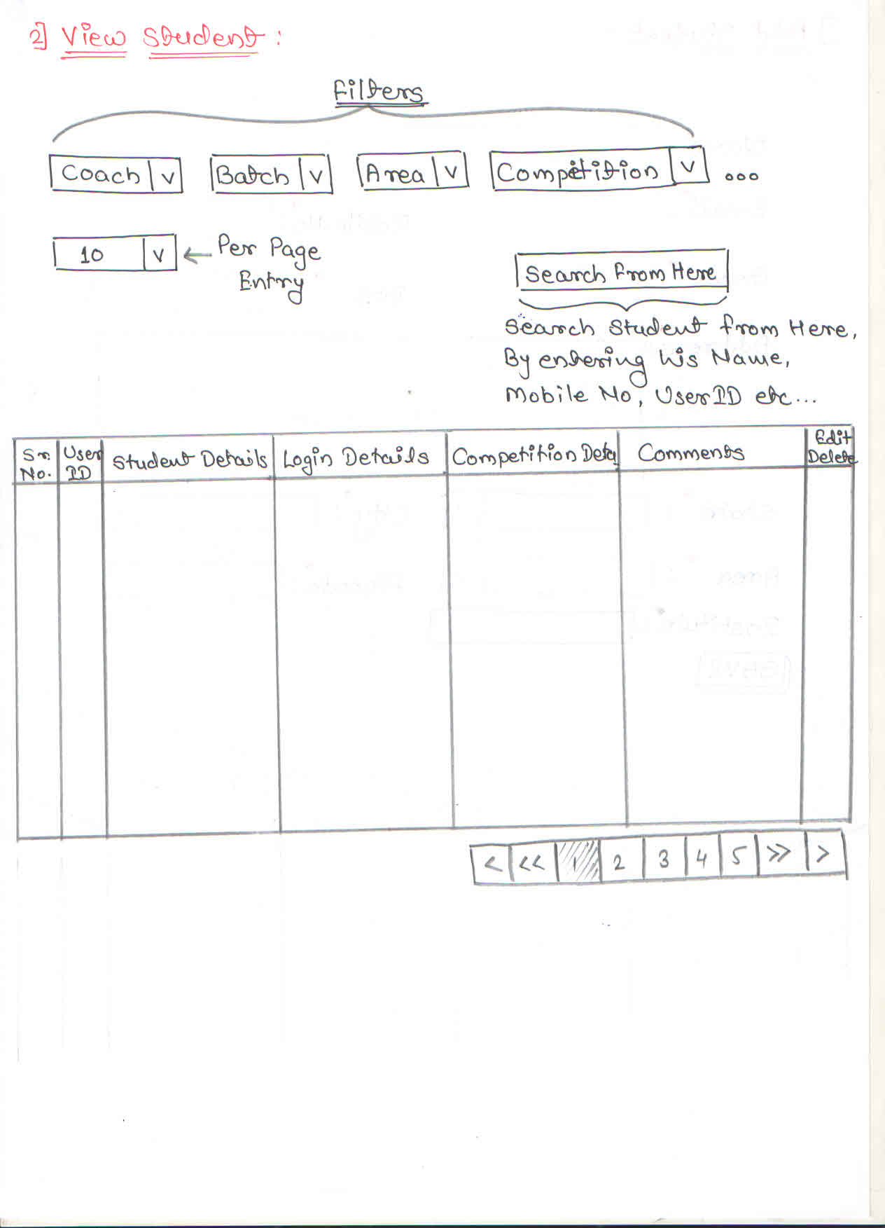
Wireframes
View Student [My Account]

Slide 26
Phase I
Notification
Bulk Notification
Bulk notification is used to send notifications to entire City, Area or any preferred Batch or Competition.
Individual Notification
Individual notification is used to send notification on individual basis. Searching Options: Name, Email, Contact number Or User-id.

Slide 27
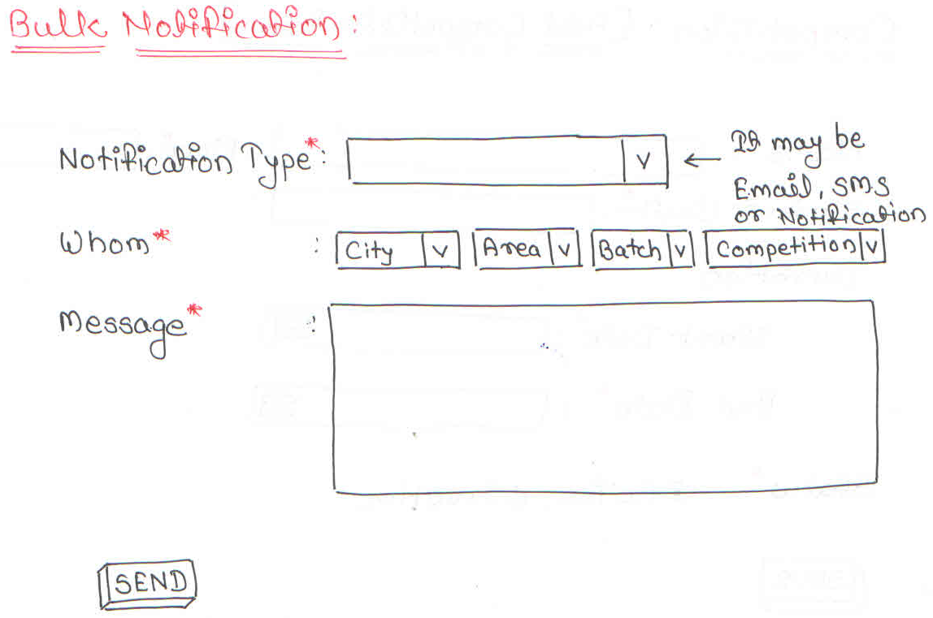
Wireframes
Bulk Notification

Slide 28
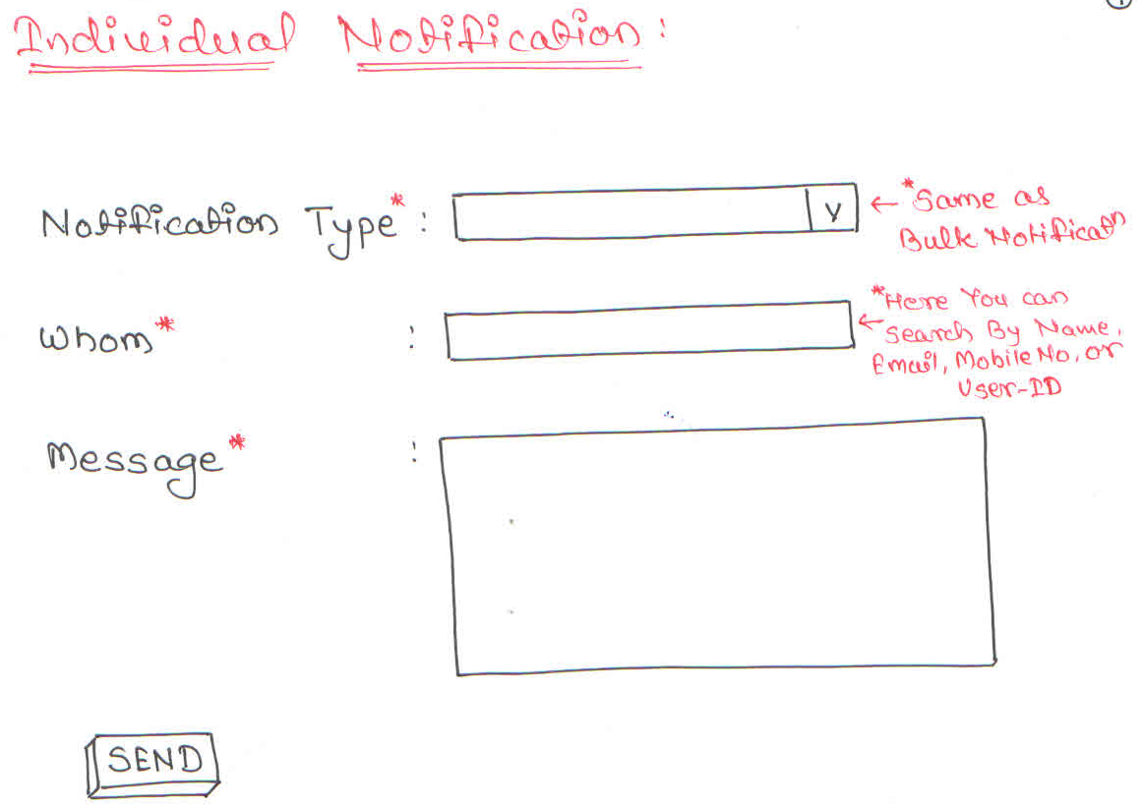
Wireframes
Individual Notification

Slide 29
Phase I
Reports
Competition Reports
Filters can be applied for e.g. Batch, Date, Coach etc. One can view the competition details when clicked on Competition Name and new pop-up window will appear beside the table which includes the students participated in that competition.
Batch Reports
Filters can be applied for e.g. Date, Coach etc. One can view the Batch details when clicked on Batch Name and new pop-up window will appear beside the table which includes the students of that particular Batch.
Notification Reports Filters like Notification type, Date Range, etc. are available to fetch the notification send in all.

Slide 30
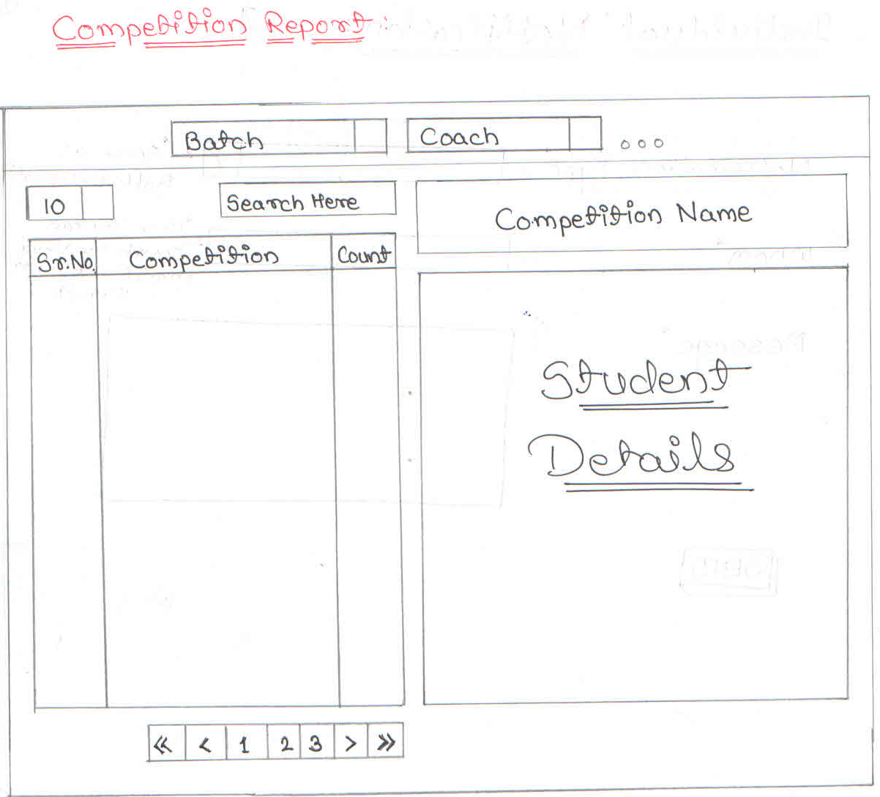
Wireframes
Competition Report

Slide 31
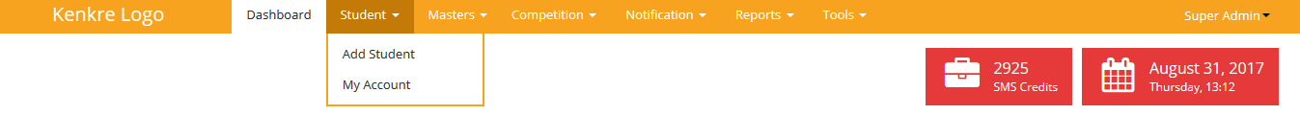
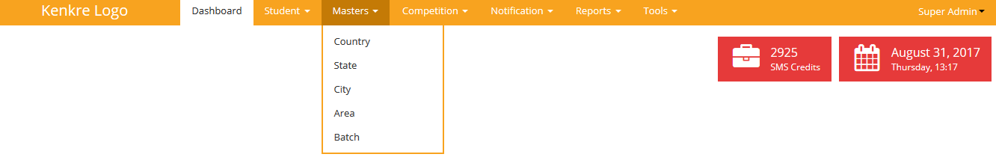
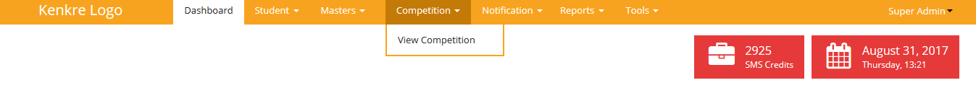
Wireframes
Menus and sub menus

Slide 32
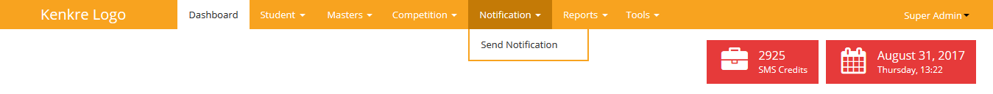
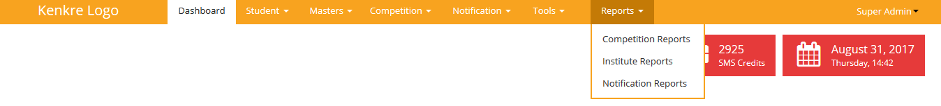
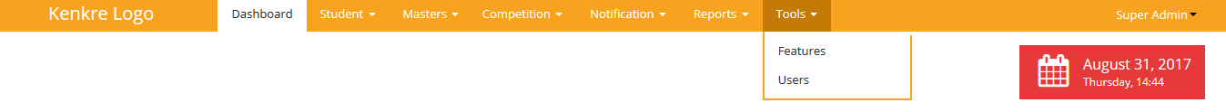
Wireframes
Menus and sub menus

Slide 33
Phase II
Modules
Fee Management
Student Login (Front End)

Slide 34
Phase III
All the Modules will be also made for Mobile Application.

Slide 35
Thank you!

